Slide 1
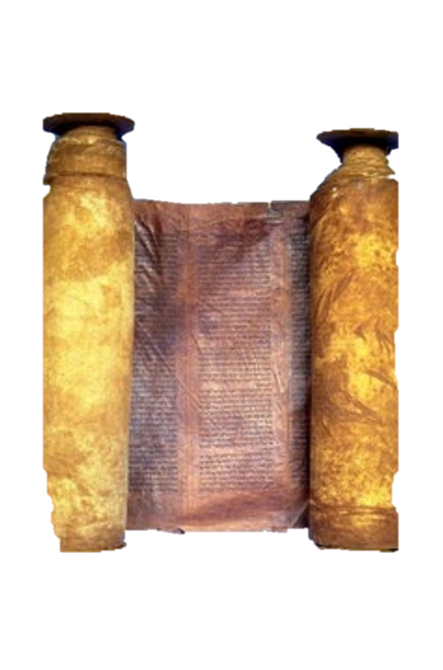
A free CD of this message will be available immediately following the service
1 Kings
17-18
A podcast will also be available later this week at calvaryokc.com

Slide 2
Jezebel ~ Where is Baal?
zebel is Hebrew for dung
1 kings 17-18

Slide 3
1 kings 17-18

Slide 4
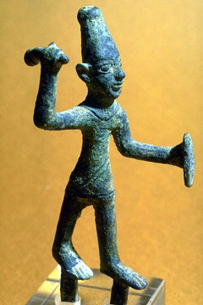
Elijah ~ Yahweh is my God
1 kings 17-18

Slide 5
Tishbe
Brook Cherith
1 kings 17-18

Slide 6
1 kings 17-18

Slide 7
Matt. 6:33 ~ But seek first the kingdom of God and His righteousness, and all these things shall be added to you.
1 kings 17-18

Slide 8
1 kings 17-18

Slide 9
Zarephath
Tishbe
Brook Cherith
1 kings 17-18

Slide 10
1 kings 17-18

Slide 11
Carmel ~ vineyard of God
1 kings 17-18

Slide 12
1 kings 17-18

Slide 13
Busy ~ (The Living Bible) sitting on the toilet
1 kings 17-18

Slide 14
1 kings 17-18

Slide 15
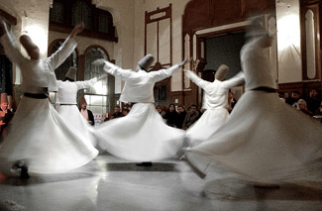
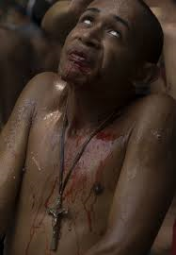
1 kings 17-18

Slide 16
1 kings 17-18

